Slide 1
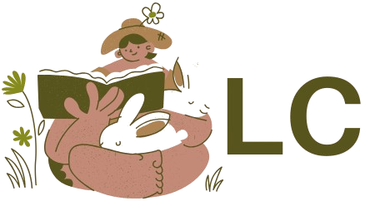
OLC
Online Lit Club

Slide 2

THE POWER OF COMMUNITY

Slide 3
Product Overview: Connecting Readers, Anywhere, Anytime
Longing to recommend a book to people after reading it
Can’t stop talking about something you read? Make a post about it
Like minded individuals fostering a community
Fitting in
Don’t be shy!

Slide 4

WHO IS OLC FOR?

Slide 5
YOU
YOU! if you like books and if you like talking
People who want a community but are hindered in some way
Educators

Slide 6
FEEDBACK

Slide 7
EFFECTIVE DELIVERY TECHNIQUES
Positives
Beautiful Design
Clever Functionality
Future Improvement
Books page that fetches books from an API
Needs met?
Yes, every feature of this website is relevant, they can see themselves using it.

Slide 8

FUTURE ENHANCEMENTS?

Slide 9
Future Enhancements
An algorithm that recommends you books and clubs based on your register preferences
Section dedicated to books
Mobile App Development:
Integration with goodreads

Slide 10
Challenges and Lessons Learned
Having a clear roadmap does save you a lot of time
Testing and User stories help a lot
Don’t underestimate the frontend
Sprints are important
Leave enough time!

Slide 11
THANK YOU
Udoeyop David
5713566995
dudoeyop@uncc.edu

